Slide 1
Fandango movie rating discrepancy analysis
CAPSTONE PROJECT
Presented By:
1. M ARIVAZHAGAN-8144-Sudharsan Engineering College-EEE

Slide 2
OUTLINE
Problem Statement
Proposed System/Solution
System Development Approach
Algorithm & Deployment
Result
Conclusion
Future Scope
References

Slide 3
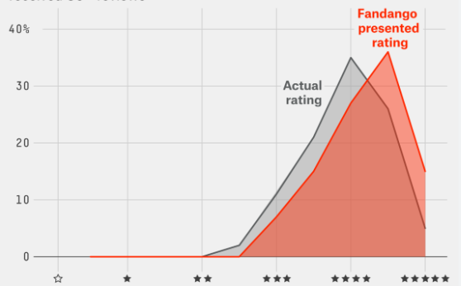
Problem Statement
Fandango's movie ratings have been under scrutiny since 2015, with concerns raised about inflated ratings compared to other platforms.
Lack of transparency and credibility in Fandango's rating system.Need to investigate the extent of rating inflation and identify any systematic biases.

Slide 4
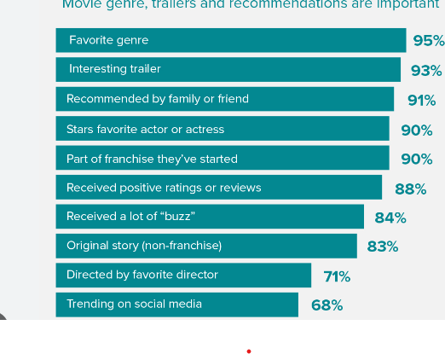
Proposed Solution
Conduct a comprehensive analysis comparing Fandango's movie ratings with those of other popular platforms.Utilize statistical techniques to quantify discrepancies and identify patterns in rating distributions.Evaluate changes in Fandango's rating system and practices since the 2015 investigation.

Slide 5
System Approach
Data Collection:Gather movie rating data from Fandango and other platforms (e.g., Rotten Tomatoes, IMDb).Focus on recent movie releases post-2015 to ensure relevance.
Data Analysis:Perform descriptive statistics, hypothesis testing, and data visualization to compare ratings across platforms.Identify any systematic biases in Fandango's ratings and determine their direction.
Reporting:Prepare a comprehensive report documenting findings, insights, and recommendations.Present results to stakeholders through visual aids and presentations.

Slide 6
Algorithm & Deployment
Utilize statistical algorithms for data analysis, including measures of central tendency, hypothesis testing (e.g., t-tests), and regression analysis.Deployment involves sharing findings and recommendations with Fandango's management and stakeholders for consideration and action.

Slide 7
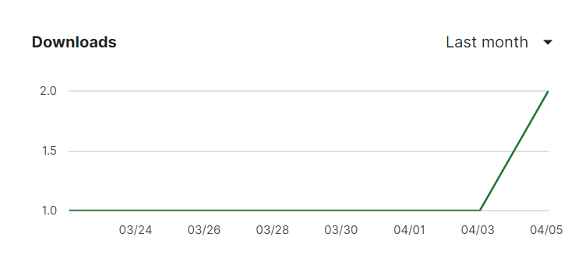
Result
Quantification of rating discrepancies between Fandango and other platforms.Identification of any systematic biases in Fandango's ratings.Insights into changes in Fandango's rating system and their impact on rating distribution.

Slide 8
Conclusion
The analysis provides transparency into Fandango's rating practices and highlights areas for improvement.Recommendations aim to enhance the credibility and trustworthiness of Fandango's rating system.

Slide 9
Future scope
Continuous monitoring and analysis of Fandango's rating system to ensure transparency and fairness.Exploration of advanced statistical techniques and machine learning algorithms for deeper insights.Collaboration with industry stakeholders to establish standardized rating practices across platforms.

Slide 10
References
Fandango. (https://www.fandango.com/)
Rotten Tomatoes. (https://www.rottentomatoes.com/)

Slide 11
THANK YOU

